Slide 1

分布式训练系列
混合并行
ZOMI

Slide 2
深度学习迎来大模型（Foundation Models）
自监督学习方法，可以减少数据标注，降低训练研发成本
模型参数规模越大，有望进一步突破现有模型结构的精度局限
解决模型碎片化，提供预训练方案
e.g. 语言模型 GPT-3
8 张 V100，训练时长 36 年
512 张 V100，训练近 7 个月

Slide 4
About 关于本内容
具体内容
大模型训练挑战
AI框架的分布式
AI集群架构
AI集群通信
大模型算法
分布式并行算法
大模型混合并行：推荐大模型 – LLM大模型
内存和计算优化
分布式并行总结

Slide 5
DLRM 推荐大模型
CTR，Click-Through-Rate，点击率预估模型
Continuous features:
用户本身特征：用户的年龄、性别等；
用户行为特征：点击/购买过的物品等；
上下文特征：用户登录设备、当前时间等；
Categorical features 待排序物品特征：
物品 ID；
物品商品信息；
物品被点击次数；
物品点击率等；
Naumov, Maxim, et al. "Deep learning recommendation model for personalization and recommendation systems." arXiv preprint arXiv:1906.00091 (2019).

Slide 6
DLRM 推荐大模型
Diagram of DLRM architecture.
Naumov, Maxim, et al. "Deep learning recommendation model for personalization and recommendation systems." arXiv preprint arXiv:1906.00091 (2019).

Slide 7
DLRM 推荐大模型
Table-wise split mode is when each GPU stores a subset of all the embedding tables
Column-wise split mode is when each device stores a subset of columns from every embedding table
Naumov, Maxim, et al. "Deep learning recommendation model for personalization and recommendation systems." arXiv preprint arXiv:1906.00091 (2019).

Slide 8
DLRM 推荐大模型
General hybrid-parallel approach for training large recommender systems
Naumov, Maxim, et al. "Deep learning recommendation model for personalization and recommendation systems." arXiv preprint arXiv:1906.00091 (2019).

Slide 9
DLRM 推荐大模型
Naumov, Maxim, et al. "Deep learning recommendation model for personalization and recommendation systems." arXiv preprint arXiv:1906.00091 (2019).

Slide 10
DLRM 推荐大模型
Naumov, Maxim, et al. "Deep learning recommendation model for personalization and recommendation systems." arXiv preprint arXiv:1906.00091 (2019).

Slide 11
DLRM 推荐大模型
Comparison of CPU and GPU training throughput for a 113-billion parameter Deep Learning Recommendation Model (DLRM).
Hardware | Throughput [samples/second] | Speedup over CPU
2xAMD EPYC 7742 | 17.7k | 1x
A100-80GB + 2xAMD EPYC 7742(large embeddings on CPU) | 768k | 43x
DGX A100 (8xA100-80GB) (hybrid parallel) | 11.9M | 672x
Naumov, Maxim, et al. "Deep learning recommendation model for personalization and recommendation systems." arXiv preprint arXiv:1906.00091 (2019).

Slide 12
Megatron-LM 语言大模型
Narayanan, Deepak, et al. "Efficient large-scale language model training on gpu clusters using megatron-lm." Proceedings of the International Conference for High Performance Computing, Networking, Storage and Analysis. 2021.

Slide 13
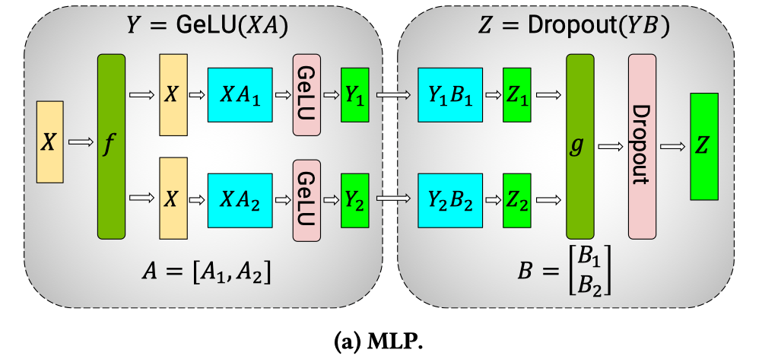
Megatron-LM 语言大模型
Narayanan, Deepak, et al. "Efficient large-scale language model training on gpu clusters using megatron-lm." Proceedings of the International Conference for High Performance Computing, Networking, Storage and Analysis. 2021.

Slide 14
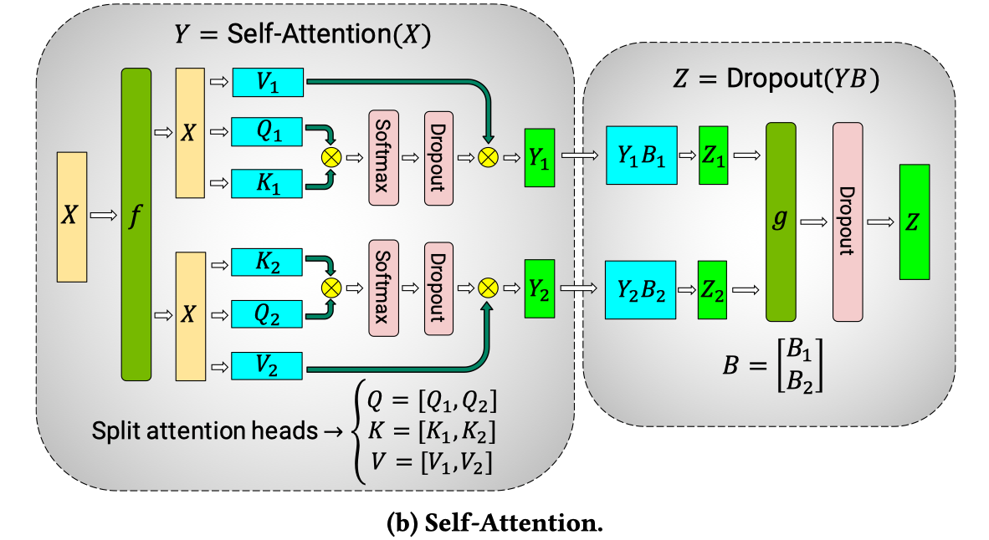
Megatron-LM 语言大模型
Narayanan, Deepak, et al. "Efficient large-scale language model training on gpu clusters using megatron-lm." Proceedings of the International Conference for High Performance Computing, Networking, Storage and Analysis. 2021.

Slide 15
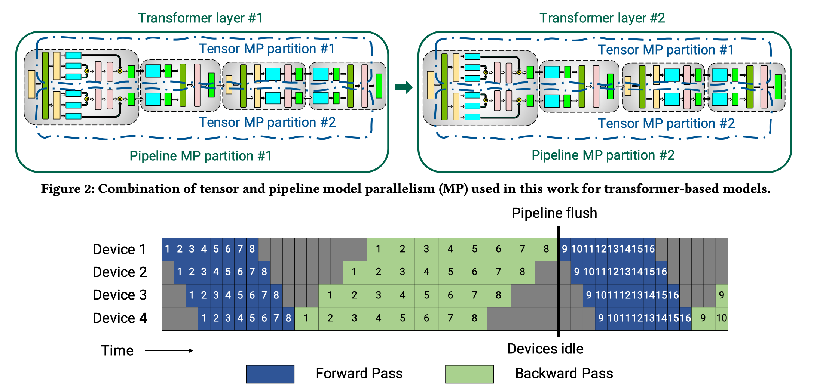
Megatron-LM 语言大模型
Narayanan, Deepak, et al. "Efficient large-scale language model training on gpu clusters using megatron-lm." Proceedings of the International Conference for High Performance Computing, Networking, Storage and Analysis. 2021.

Slide 16
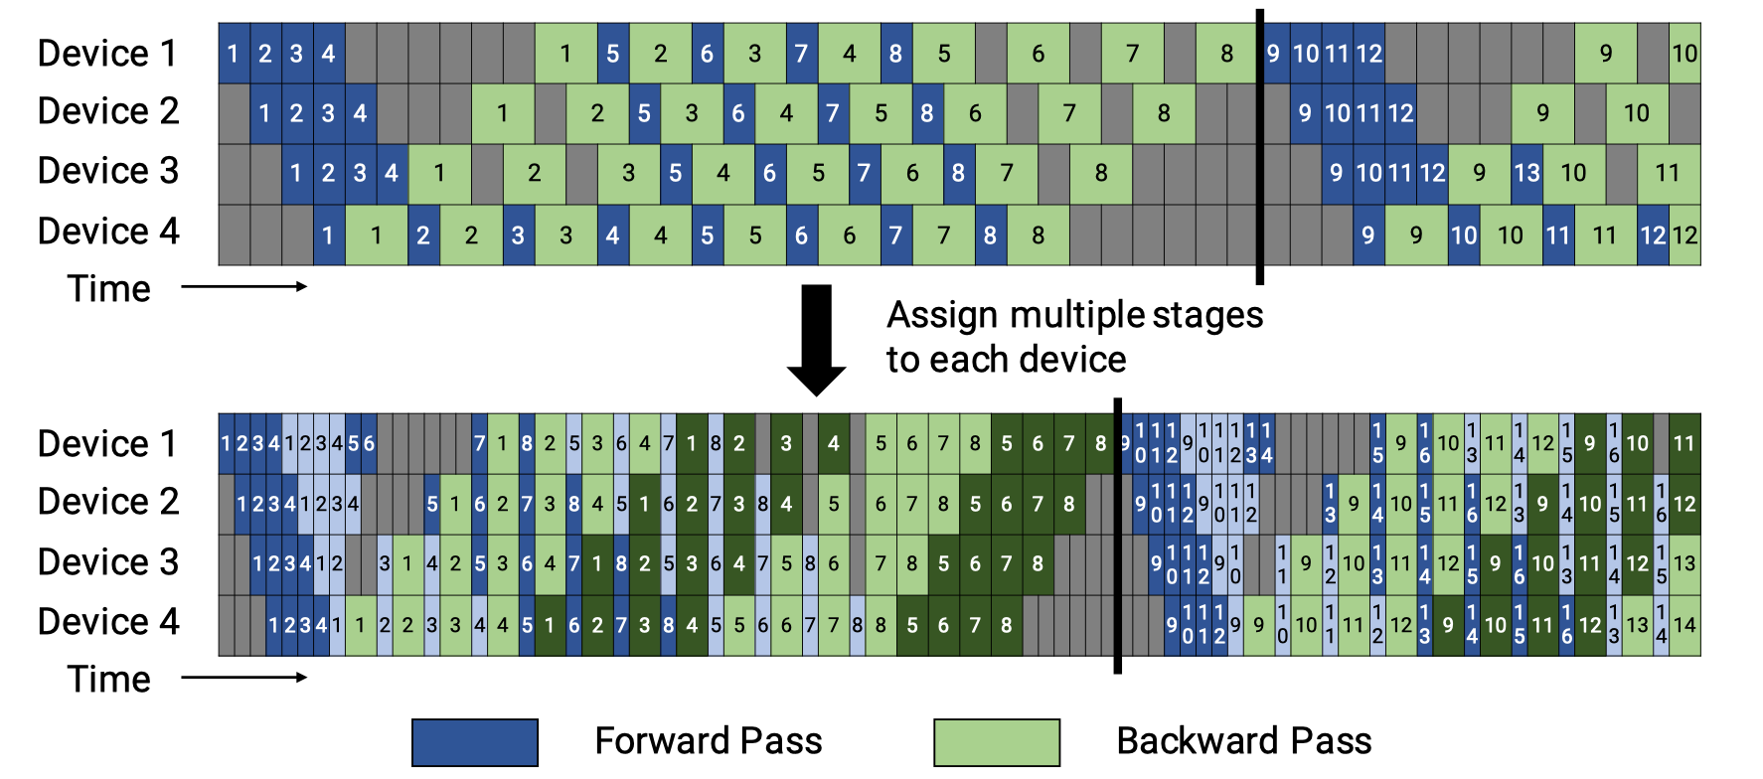
Megatron-LM 语言大模型
virtual pipeline
Narayanan, Deepak, et al. "Efficient large-scale language model training on gpu clusters using megatron-lm." Proceedings of the International Conference for High Performance Computing, Networking, Storage and Analysis. 2021.

Slide 17
Megatron-LM 语言大模型
在 device 数量不变的情况下，分出更多的 pipeline stage，以更多的通信量，换取空泡比率降低

Slide 18
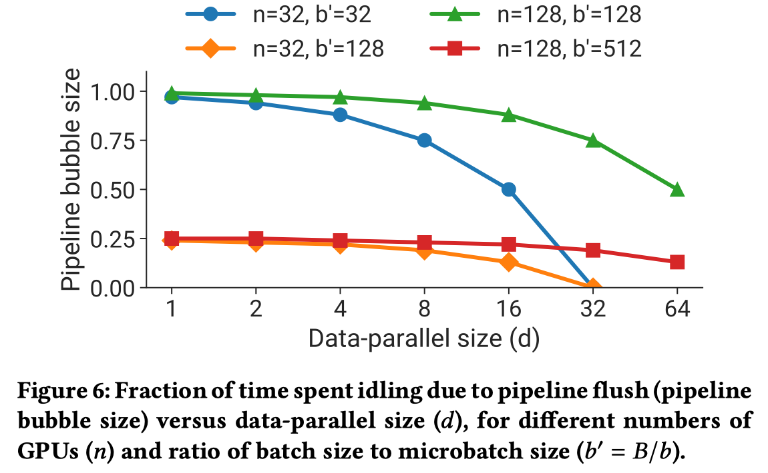
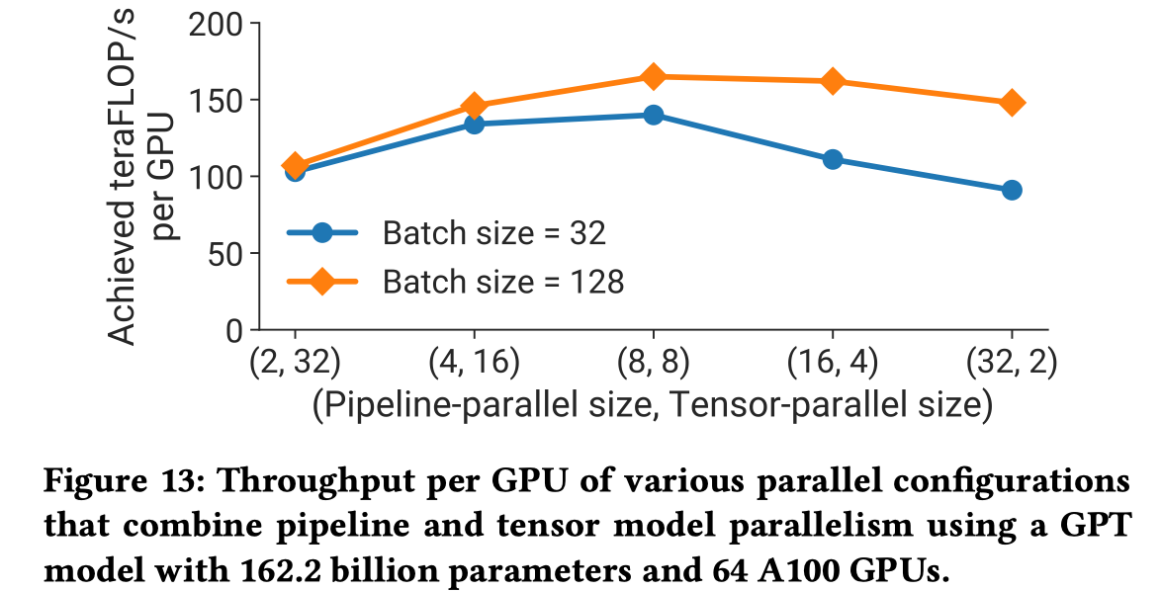
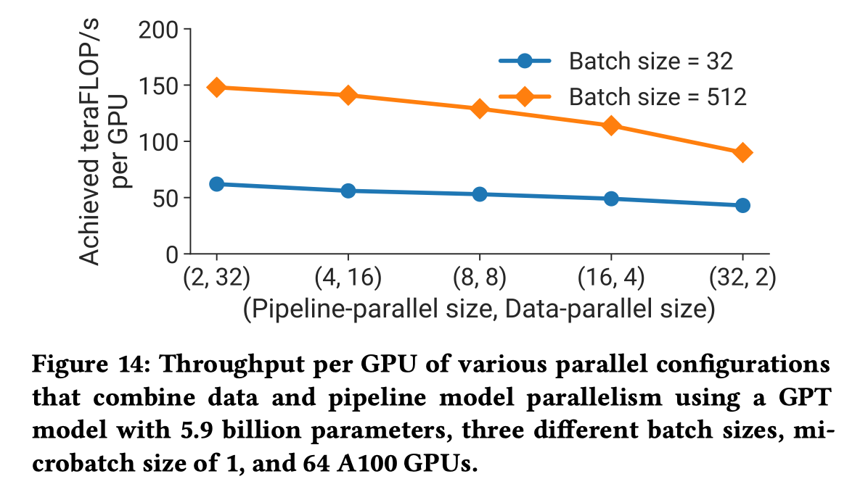
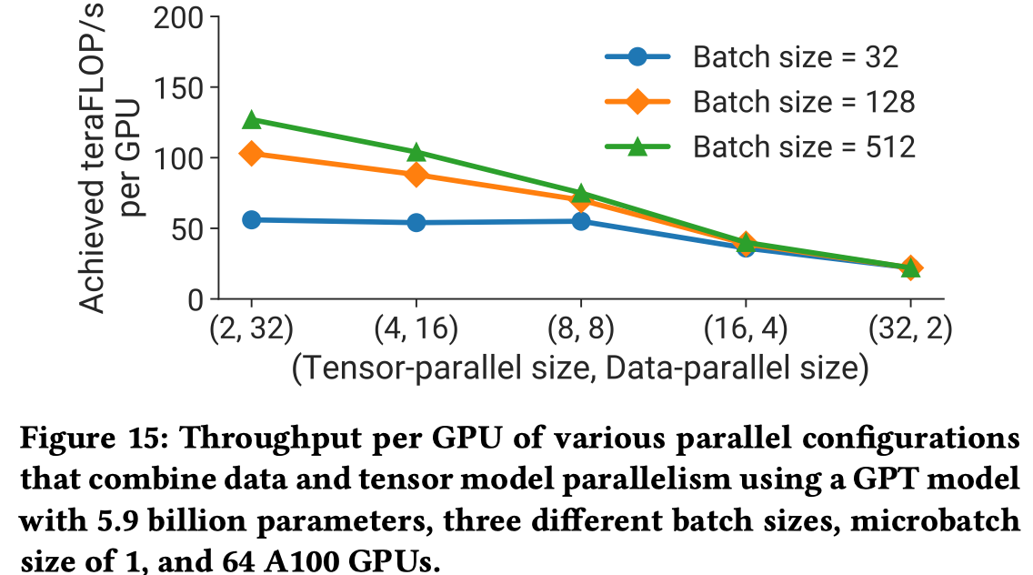
Megatron-LM 语言大模型
Narayanan, Deepak, et al. "Efficient large-scale language model training on gpu clusters using megatron-lm." Proceedings of the International Conference for High Performance Computing, Networking, Storage and Analysis. 2021.

Slide 19
Inference
https://zhuanlan.zhihu.com/p/450854172 全网最全-超大模型+分布式训练架构和经典论文
Naumov, Maxim, et al. "Deep learning recommendation model for personalization and recommendation systems." arXiv preprint arXiv:1906.00091 (2019).
Narayanan, Deepak, et al. "Efficient large-scale language model training on gpu clusters using megatron-lm." Proceedings of the International Conference for High Performance Computing, Networking, Storage and Analysis. 2021.
https://developer.nvidia.com/blog/training-a-recommender-system-on-dgx-a100-with-100b-parameters-in-tensorflow-2/
https://developer.nvidia.com/blog/fast-terabyte-scale-recommender-training-made-easy-with-nvidia-merlin-distributed-embeddings/

Slide 20
Notes:
20

